Slide 2
Revision on practical course of Medical Biochemistry for 1st year medical students
BY Dr. Naglaa Ibrahim Azab
Assistant professor of medical biochemistry
Tests done and photos taken by
Mr. Tarek a laboratory technician

Slide 3
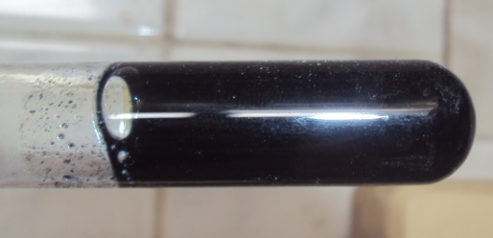
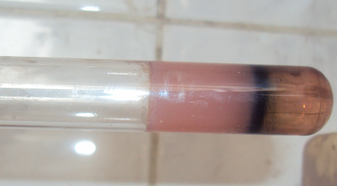
1- The following tests were done to unknown solution:
Molisch test
Iodine test
The observation of Molisch test is …………………………… and this indicates that the solution is ……………………….
The observation of Iodine test is …………………………… and this indicates that the solution is ……………………….
the unknown solution is……………………………..
The aspect of this unknown solution is expected to be …………………………

Slide 4
1- The following tests were done to unknown solution:
Molisch test
Iodine test
The observation of Molisch test is the appearance of reddish violet ring and this indicates that the solution is carbohydrate
The observation of Iodine test is the appearance of blue colour and this indicates that the solution is starch
the unknown solution is starch
The aspect of this unknown solution is expected to be turbid

Slide 5
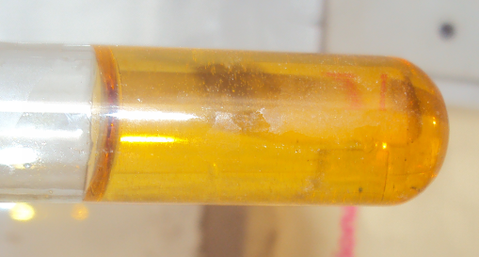
2- The following tests were done to unknown solution:
Molisch test
Iodine test
The observation of Molisch test is …………………………… and this indicates that the solution is ……………………….
The observation of Iodine test is …………………………… and this indicates that the solution is ……………………….
What is the following test to be done in order to identify the unknown solution? What are its possible results?.........................

Slide 6
The observation of Molisch test is the appearance of reddish violet ring and this indicates that the solution is carbohydrate
The observation of Iodine test is the absence of blue colour and this indicates that the solution is not starch
What is the following test to be done in order to identify the unknown solution? What are its possible observations and results? Fehling test.
- Either appearance of red precipitate indicating that the solution is reducing sugar
- Or no appearance of red precipitate indicating that the solution is not reducing sugar

Slide 7
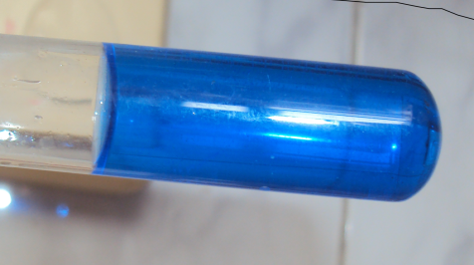
3- The following tests were done to unknown solution:
Molisch test
Iodine test
Fehling test
The observation of Molisch test is …………………………… and this indicates that the solution is ……………………….
The observation of Iodine test is …………………………… and this indicates that the solution is ……………………….
The observation of Fehling test is …………………………… and this indicates that the solution is ……………………….
the unknown solution is……………………………..

Slide 8
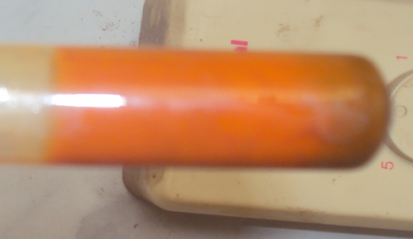
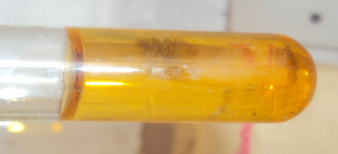
3- The following tests were done to unknown solution:
Molisch test
Iodine test
Fehling test
The observation of Molisch test is …………………………… and this indicates that the solution is ……………………….
The observation of Iodine test is …………………………… and this indicates that the solution is ……………………….
The observation of Fehling test is …………………………… and this indicates that the solution is ……………………….
The following test to do to identify the unknown solution is……………………………..

Slide 9
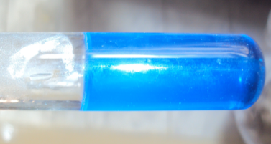
3- The following tests were done to unknown solution:
Molisch test
Iodine test
Fehling test
Barfoed test
The observation of Molisch test is …………………………… and this indicates that the solution is ……………………….
The observation of Iodine test is …………………………… and this indicates that the solution is ……………………….
The observation of Fehling test is …………………………… and this indicates that the solution is ……………………….
The observation of Barfoed test with boiling for 4 minutes is …………………………… and this indicates that the solution is ……………………….
the unknown solution is……………………………..

Slide 10
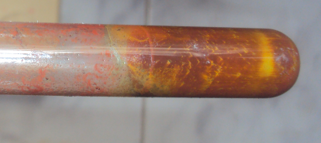
3- The following tests were done to unknown solution:
Molisch test
Iodine test
Fehling test
Barfoed test
The observation of Molisch test is …………………………… and this indicates that the solution is ……………………….
The observation of Iodine test is …………………………… and this indicates that the solution is ……………………….
The observation of Fehling test is …………………………… and this indicates that the solution is ……………………….
The observation of Barfoed test with boiling for 2 minutes is …………………………… and this indicates that the solution is ……………………….
The following test to do to identify the unknown solution is……………………………..

Slide 11
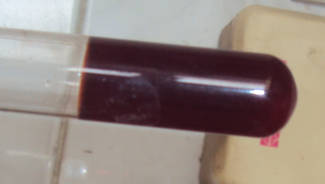
3- The following tests were done to unknown solution:
Molisch test
Iodine test
Fehling test
Barfoed test
Selwanoff test

Slide 12
The observation of Molisch test is ………………………… and this indicates that the solution is …………………….
The observation of Iodine test is …………………………… and this indicates that the solution is …………………….
The observation of Fehling test is ………………………… and this indicates that the solution is …………………….
The observation of Barfoed test after boiling for 2 mins is ………………………… and this indicates that the solution is …………………….
The observation of Selwanoff test after boiling for 2 mins is ……………………… and this indicates that the solution is …………………….
the unknown solution is……………………………..

Slide 13
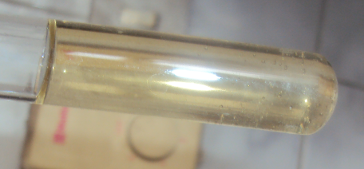
3- The following tests were done to unknown solution:
Molisch test
Iodine test
Fehling test
Barfoed test
Selwanoff test

Slide 14
The observation of Molisch test is ………………………… and this indicates that the solution is …………………….
The observation of Iodine test is …………………………… and this indicates that the solution is …………………….
The observation of Fehling test is ………………………… and this indicates that the solution is …………………….
The observation of Barfoed test after boiling for 2 mins is ………………………… and this indicates that the solution is …………………….
The observation of Selwanoff test after boiling for 2 mins is ……………………… and this indicates that the solution is …………………….
the unknown solution is……………………………..

Slide 15
This is Molisch test done for an unknown solution
Molisch test is used to differentiate between …………CHO………………… and ………non CHO………… solution.
The reddish violet ring observed in Molisch test indicates that the unknown solution is ………………CHO……….
The reddish violet ring observed in Molisch test is due to the condensation of …………furfural………… with ……………α- naphthol…………………..

Slide 16
This is iodine test done for an unknown CHO solution
Iodine test is used to differentiate between ……………….. ..polysaccharide…… and …… non polysaccharide …………… solutions.
The blue colour observed in Molisch test indicates that the unknown solution is …………Starch (polysaccharide)………….
The blue colour observed in Molisch test is due to the formation of …micelles…… which adsorb iodine. This is due to the …polysaccharide…… nature of …starch….

Slide 17
This is Fehling test done for an unknown CHO solution
Fehling test is used to differentiate between ……………….. ..reducing sugar (reducing CHO)…… and …… non reducing sugar….
The red precipitate observed in Fehling test indicates that the unknown solution is …… reducing sugar ……………….
The red precipitate observed in Fehling test is due to the formation of …cupric hydroxide……

Slide 18
This is Barfoed test done for an reducing CHO solution
Barfoed test is used to differentiate between ……………….. ..monosaccharides…… and …… disaccharides….
In Barfoed test, the appearance of red precipitate in 2 minutes indicates that the unknown solution is …… monosaccharide , while its appearance after 10 minutes indicates that the unknown solution is …… disaccharide ……………….
The red precipitate observed in Barfoed test is due to the reduction of…copper ions……

Slide 19
This is Seliwanoff test done for an reducing monosaccharide solution
Seliwanoff test is used to differentiate between ……………….. ..monosaccharides…… and …… disaccharides….
In Seliwanoff test, the appearance of red colour in 2 minutes indicates that the unknown solution is …… ketose..as…fructose , while its appearance after 10 minutes indicates that the unknown solution is …… aldose… as ….glucose ……………….
The red colour observed in Barfoed test is due to the condensation of…furfural…… with ……resorcinol…..

